Slide 1


International Open Access Week
Open Access4D: Battle not won
By Dr. Muthoni Masinde
  Monday, January 25, 2016

Slide 2


Key Instruments
Infrastructure
Legal framework
Content
  African Research in Digital spaces

Slide 3
Africa’s Realities
The trend is still: “transferring of Northern designs to Southern realities”
While 41% of the world’s household have access to the Internet, Africa is lagging far behind at 9%.
Africa has abysmal penetration rate for landline telephone, the number of fixed-broadband subscriptions

Slide 4
Africa’s Realities
“Internet has increased the digital divide.... Africa is slow to take up technological innovation as most have to be imported from elsewhere..” Liam (2009)
“The emergence of Africa will ultimately be measured by its ability to sustain itself,....to create, store and disseminate its own knowledge and technology.”

Slide 5
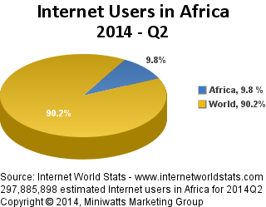
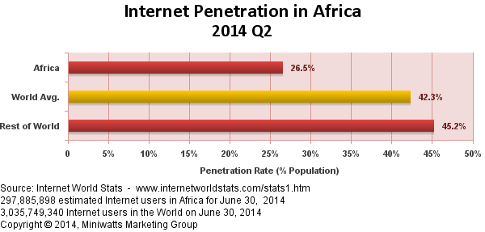
Africa’s Realities

Slide 6
Africa’s Realities
Africa has always produced for export:...”.the whole economic activity is determined by external needs and basically consists in the production and exportation of raw material needed by industrial countries…”
Academic activity has also pursued this extraversion, producing knowledge that is published elsewhere for international consumption; result -> publications not accessible in continent

Slide 7
Africa’s Realities
Limited circulation
Fewer authors and subscriptions
Circle of
limited
accessibility
Poor visibility and readership
Limited recognition
Fewer citations

Slide 8
Future Prospects
Infrastructure
    SEACOM cable
    FIFA World Cup , 2010
    Mobile technology
Content
    SARUA
    AAU...
    UNECA (United Nations Economic Commission for Africa)...

Slide 9
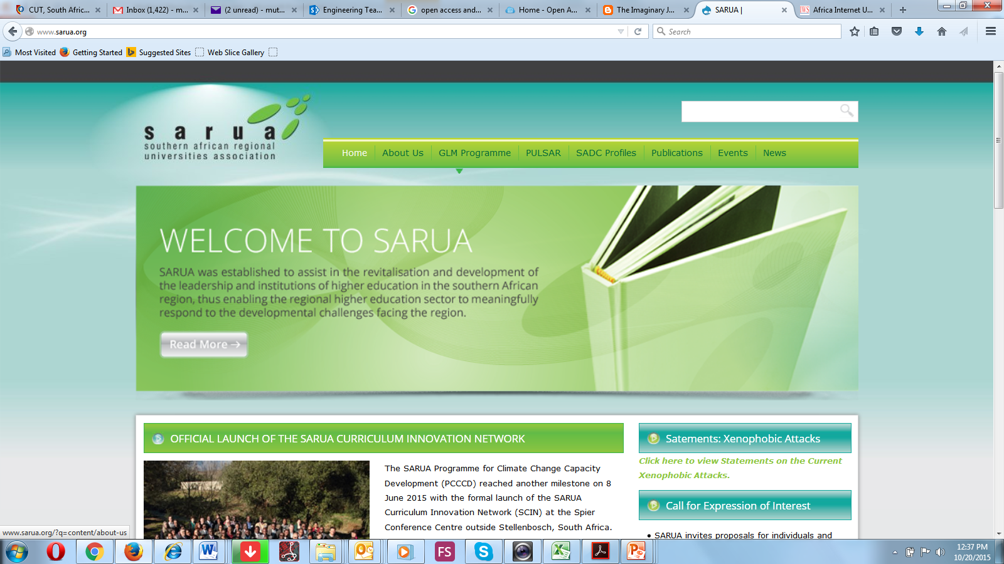
Future Prospects

Slide 10
Potential of Open access to Africa
Visibility of African scholarship
Opportunity to shape digital knowledge space through contribution---not mere consumers of digital content
Expanding intellectual and knowledge development sphere
Digital repositories expanding African ways of learning, teaching & research

Slide 11
Potential of Open access to Africa
Open access
More authors
and other benefits
Circle of
accessibility
Increased visibility
Larger readership
Wider recognition
Increased citations

Slide 12

Thank you

